Slide 1
Welcome to CSE310
Compiler Sessional
Presenter: Md Irtiaz Kabir
Adjunct Lecturer, CSE, BUET

Slide 2
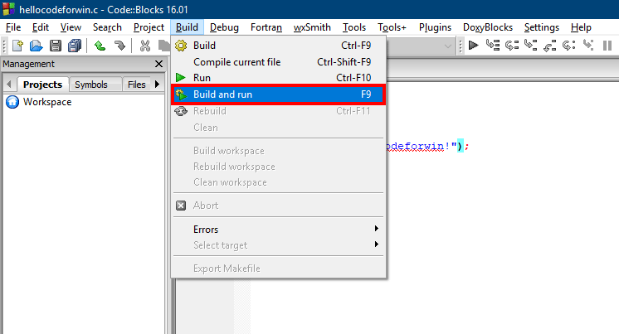
How we have compiled so far

Slide 3
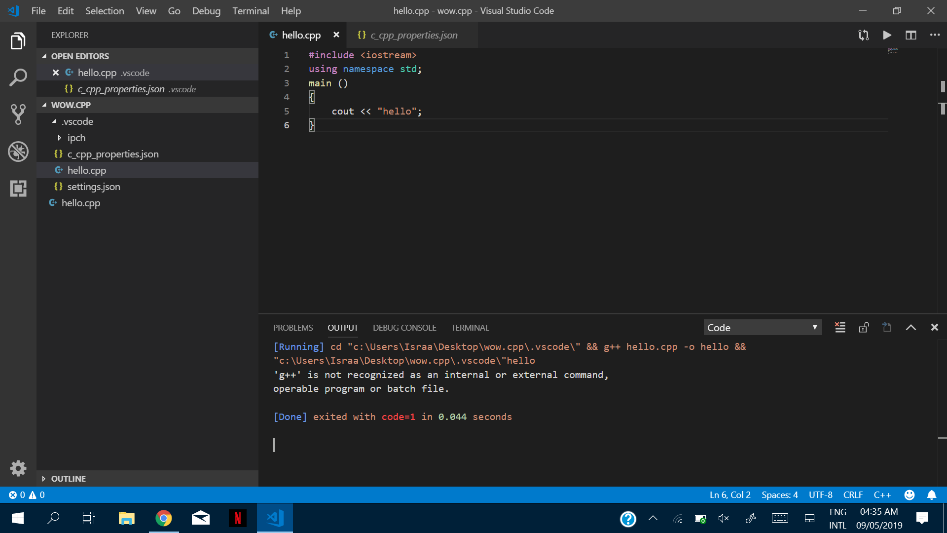
How we have compiled so far

Slide 4
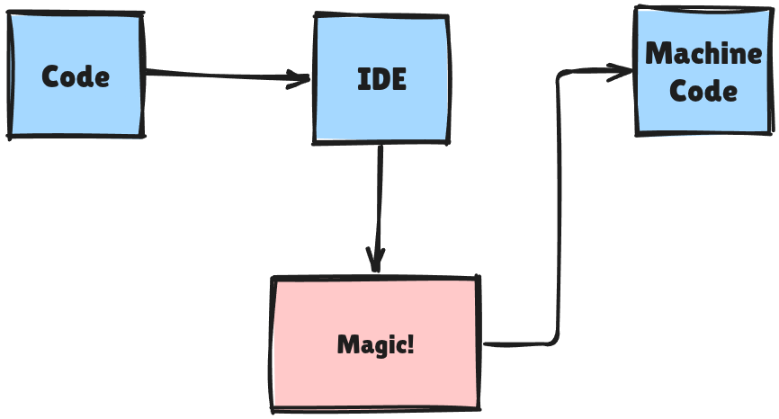
What happens under the hood
Compiler

Slide 5

We will build a compiler!
Learn how a compiler works
Build a “toy” compiler
  We focus on a subset of C
Maybe have some fun in the process

Slide 6

Some important notes
Write the entire thing from scratch
No plagiarism
No LLM generated codes

Slide 7

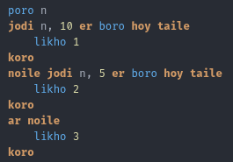
Back in my days…
I wrote my own flex + bison (from scratch)
Then my own programming language
Not a single LLM usage
In ANSI C
During PL
Jui Lang

Slide 8
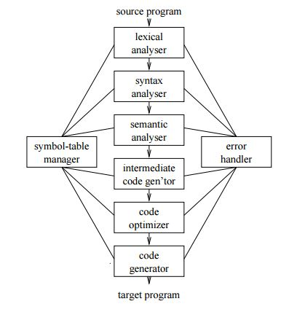
Phases of a compiler

Slide 9
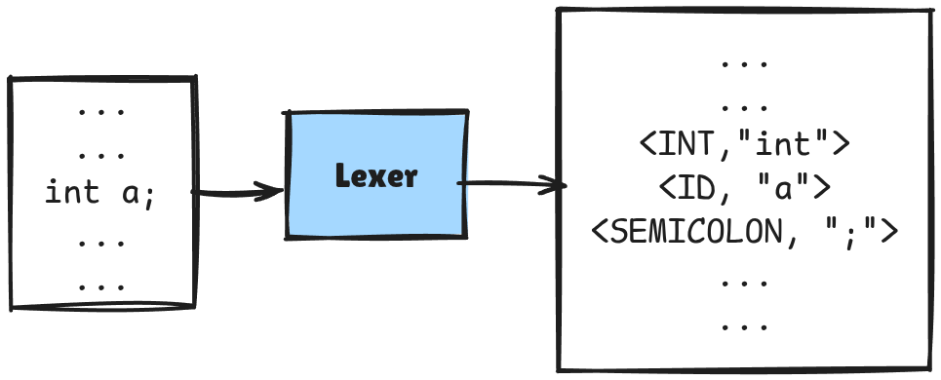
Lexical Analyzer
Source program -> stream of tokens
Passes tokens to syntax analyzer
Detects lexical errors
  ill formed numbers
  Improper variable declaration
  Unfinished strings/comments

Slide 10
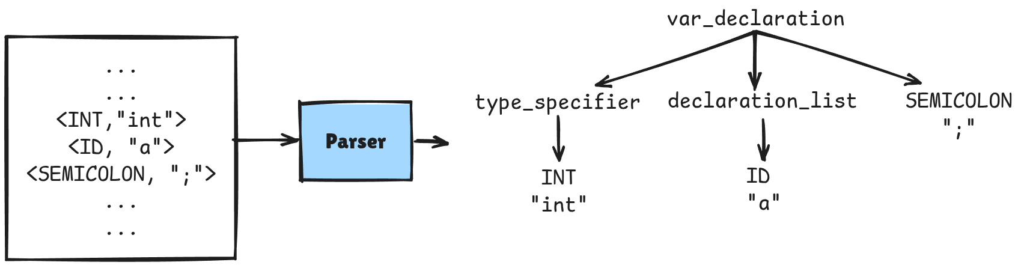
Syntax Analyzer
Stream of tokens -> Parse Tree
Parse Tree can be converted to AST
Detects syntax errors

Slide 11
Semantic Analyzer
Check semantic consistency
Can add nodes in the AST
  Implicit type conversions
Detects semantic errors
  Type checking
  Variable declared as void
  Undeclared variable
  Error in number of or type of arguments in function call

Slide 12
We first need a symbol table

Slide 13
Symbol table
A table to store symbol information
  Symbol name
  Symbol type
  Scope etc
Almost all phases refer to the symbol table for type checking

Slide 14
Basically a hash table
Symbol table is just like a hash table
Each entry in the hash table is mainly a two tuple
  <Symbol Name, Symbol Type>
Symbol Name is used as the key for hashing
Need to resolve hash collisions
  We use separate chaining

Slide 15
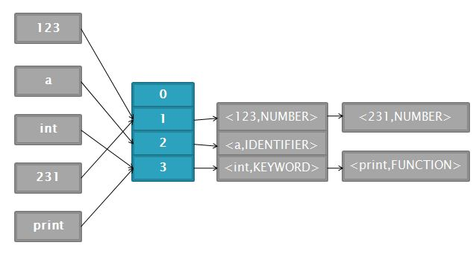
Basically a hash table

Slide 16
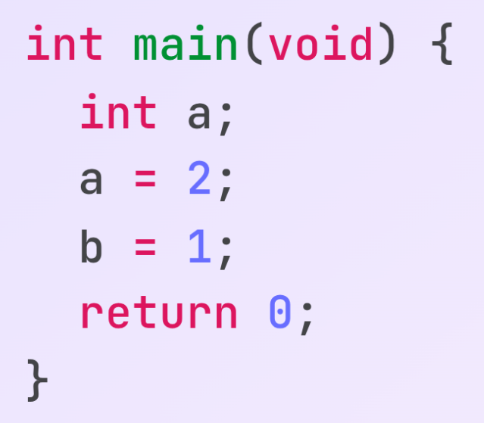
How does a symbol table help?
Detect undeclared variables
Inserting a
Searching a… SUCCESS!
Searching b… FAILED!

Slide 17
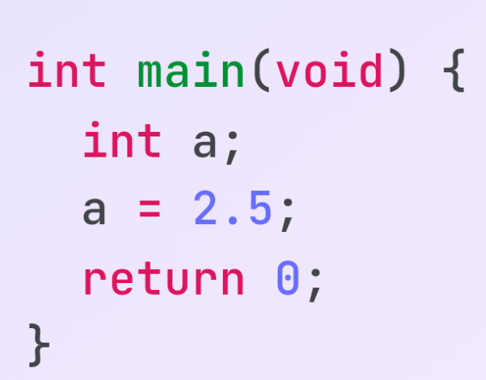
How does a symbol table help?
Type checking
Type mismatch… Implicit cast to int

Slide 18
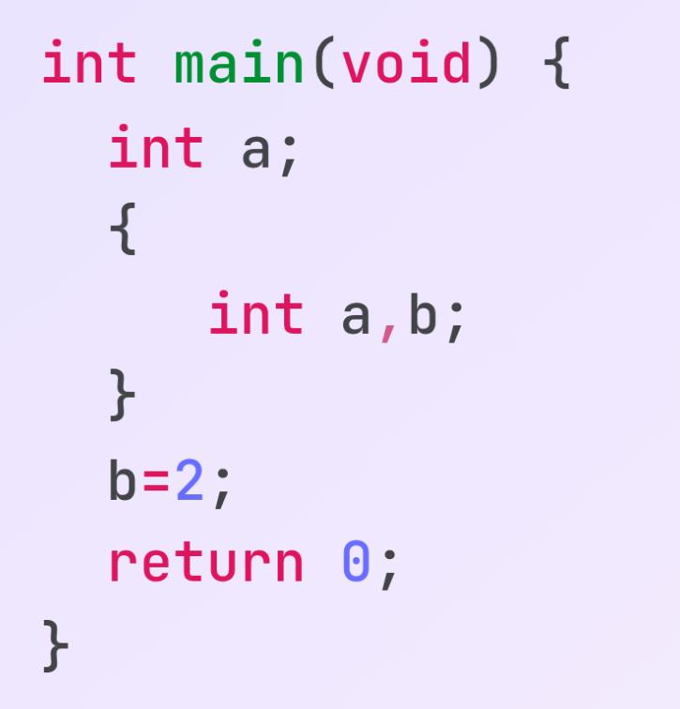
How does a symbol table help?
Scope Management
  Need to allow duplicate entries
  Need to delete some entries when a block ends

Slide 19
List of Hash Tables
Current Pointer
Current Pointer
Hash Table#1
Hash Table#2
Parent pointer
<a, var>
<a, var>
<b, var>

Slide 20
Stack of Hash Tables
Instead of a list and a current pointer, we can maintain a stack
Current scope is always the top of the stack
When accessing,
  Search the topmost stack first
  If failed, search its parent and so on

Slide 21
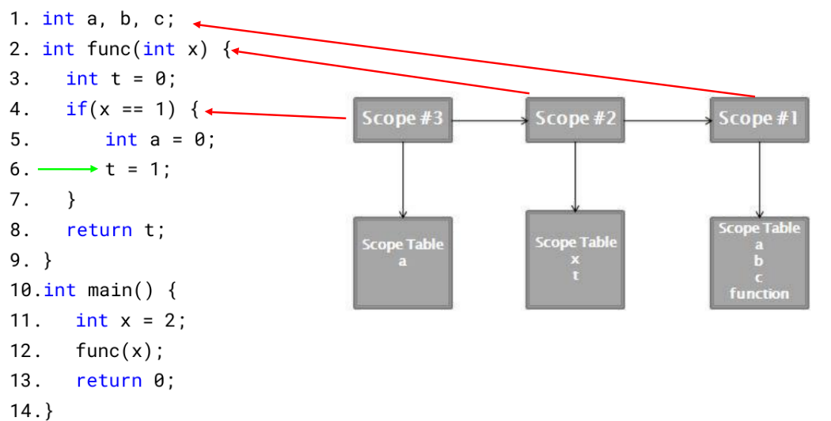
Stack of Hash Tables

Slide 22
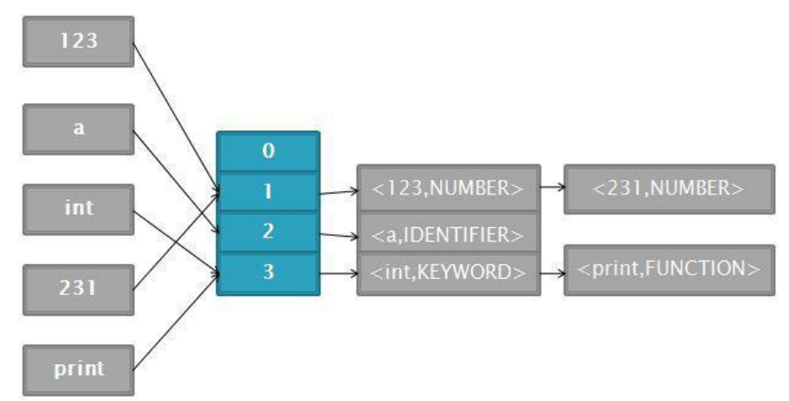
Three Classes: SymbolInfo
Each entry of symbol table is an instance of SymbolInfo
  Remember two tuples!!!
Three member vars
  Name
  Type
  Pointer to another SymbolInfo class (needed for chaining in hash table)

Slide 23
Three Classes: ScopeTable
A regular hash table
Represents each scope in the code
Implements four operations
  Insert
  Lookup
  Delete
  Print

Slide 24
Three Classes: SymbolTable
Maintains a list of Scope Tables (or a stack)
Implements six operations
  Enter Scope
  Exit Scope
  Insert
  Delete
  Print All Scope Tables
  Print Current Scope Tables

Slide 25
Cautions
There will be an online
  Plagiarism will make you suffer later
Symbol table is used in all the later offline assignments
  Any bug might snowball into a complex issue later
No memory leaks tolerated
  Use -fsanitize=address flag for auto leak detection in runtime

Slide 26
Acknowledgement
Ajmain Yasar Ahmed Sahil
Nafis Tahmid

Slide 27
Thank You!
Questions?

